Slide 1
Chapter 23: Electric Field
أ. سجى القصير
103 phys
جامعة الامام محمد بن سعود الإسلامية

Slide 2
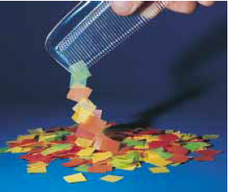
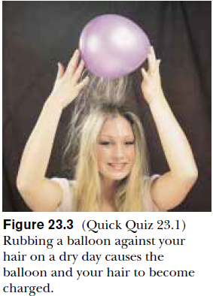
23.1 Properties of Electric Charges
Experiments
1-After running a comb through your hair on a dry day you will find that the comb attracts bits of paper.
2-Certain materials are rubbed together, such as glass rubbed with silk or rubber with fur, same effect will appear.
3-Another simple experiment is to rub an inflated balloon with wool. The balloon then adheres to a wall, often for hours.

Slide 3
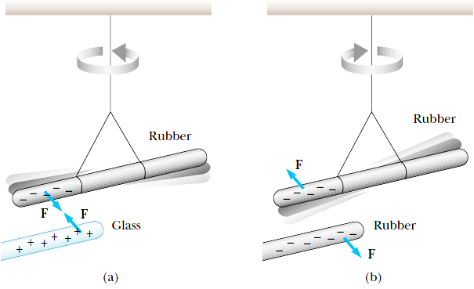
Electric Charges
There are two kinds of electric charges: positive and negative.
1. Negative charges are the type possessed by electrons.
2. Positive charges are the type possessed by protons.
* Charges of the same sign
repel one another
*Charges with opposite
signs attract one another

Slide 4
Electric Charges
* The electric charge q is said to be quantized, and exists as discrete
“packets,” and q = Ne, where N is some integer.
* The electron has a charge – e and
* The proton has a charge of equal magnitude but opposite sign + e.
* Some particles, such as the neutron, have no charge.
* Electric charge is always conserved in an isolated system.

Slide 5
Conductors
Conductors | Insulators | Semiconductors
Electrical conductors are materials in which some of the electrons are free electrons Free electrons are not bound to the atoms These electrons can move relatively freely through the material. | Electrical insulators are materials in which all of the electrons are bound to atoms. These electrons can not move relatively freely through the material. | The electrical properties of semiconductors are somewhere between those of insulators and conductors
When a good conductor is charged in a small region, the charge distributes itself over the entire surface of the material. | When a good insulator is charged in a small region, the charge is unable to move to other regions of the material. | between those of insulators and conductors
Examples of good conductors include copper, aluminum and silver. | Examples of good insulators include glass, rubber and wood. | Examples of semiconductor materials silicon and germanium.

Slide 6
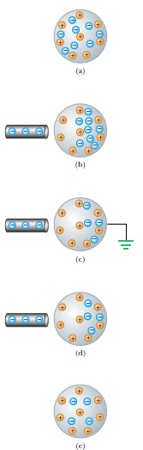
23.2 Charging Objects By Induction
Charging by induction requires no contact with the object inducing the charge.
Assume we start with a neutral metallic sphere (The sphere has the same number of positive and negative charges)
READ (page 709) the procedure of the experiment

Slide 7
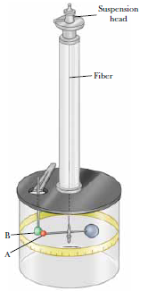
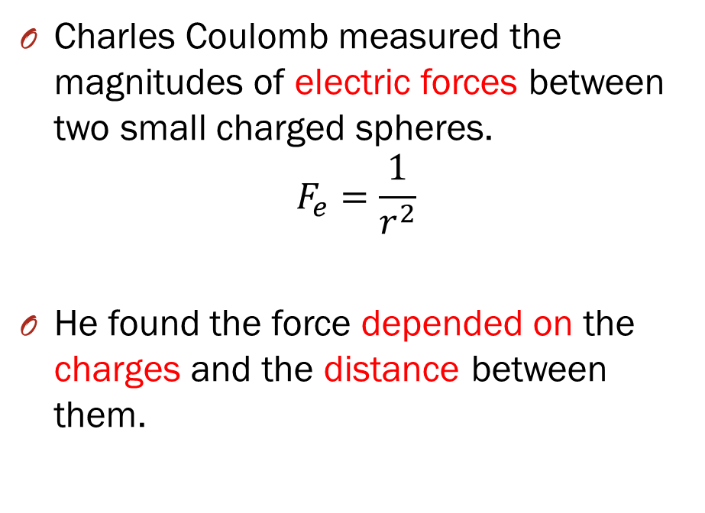
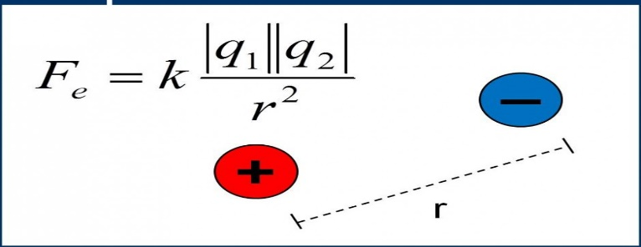
23.3 Coulomb’s Law

Slide 8
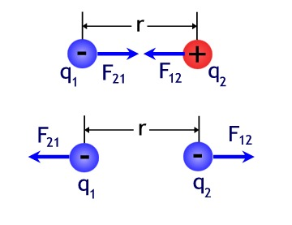
Coulomb’s experiment Results
The electric force between two stationary charged particles
Is inversely proportional to the square of the separation r between the particles and directed along the line joining them;
Is proportional to the product of the charges q₁ and q₂ on the two particles;
Is attractive if the charges are of opposite sign and repulsive if the charges have the same sign;
Is a conservative force.

Slide 9
23.3 Coulomb’s Law
The magnitude of the electric force
Where k_{e} is a constant called the Coulomb constant, depends on the choice of units. The SI unit of charge is the coulomb (C).
The Coulomb constant k_{e} in SI units has the value:
where the constant is known as the permittivity of free space and
has the value
The smallest unit of charge e known in nature is the charge on an
electron (-e) or a proton (+e) and has a magnitude

Slide 10
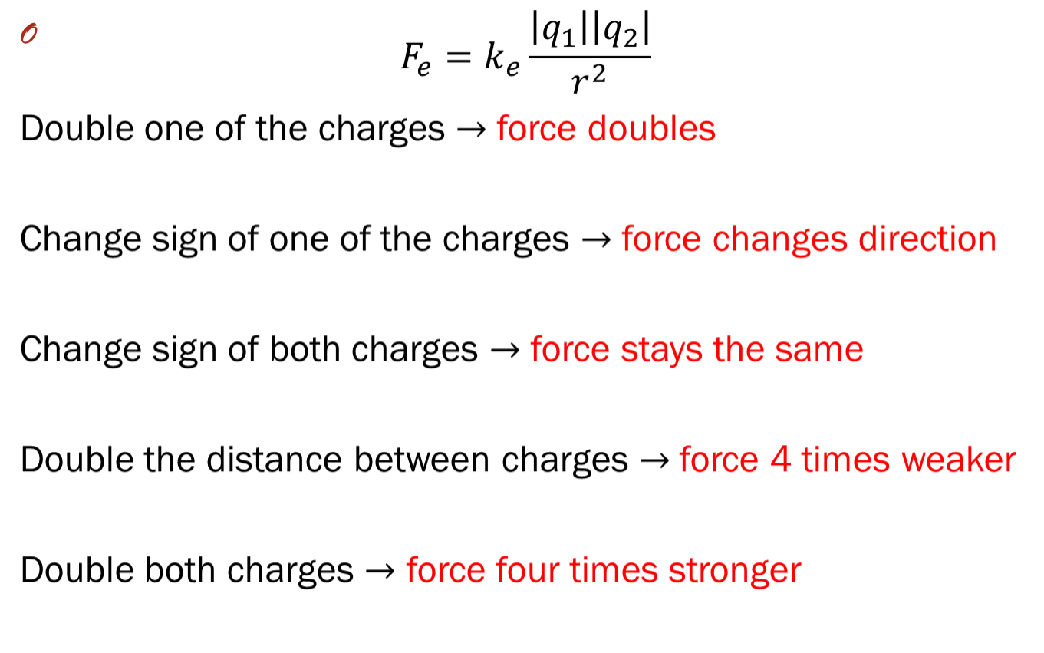
23.3 Coulomb’s Law

Slide 11
Example 1: The Hydrogen Atom
The electron and proton of a hydrogen atom are separated (on the average) by a distance of approximately 5.3 x10⁻¹¹ m. Find the magnitudes of the electric force between the two particles.

Slide 12
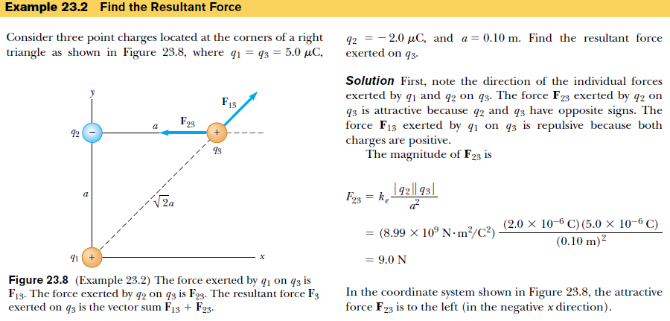
Example 2

Slide 13
Example 3
Consider three point charges at the corners of a triangle, as shown below. Find the resultant force on q₃.
y
F₃₁
F₃₂
q₂
4.00 m
37.0º
-
+
q₃
3.00 m
q₁
+
x
Observations:
The superposition principle tells us that the net force on q₃ is the vector sum of the forces F₃₂ and F₃₁.
The magnitude of the forces F₃₂ and F₃₁ can calculated using Coulomb’s law.

Slide 14
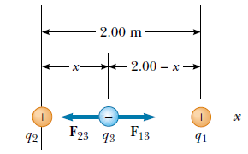
Example 4
Three point charges lie along the x axis as shown in Figure below. The positive charge q1 = 15.0 µC is at x =2.00 m, the positive charge q₂ = 6.00 µC is at the origin, and the resultant force acting on q₃ is zero. What is the x coordinate of q₃?

Slide 15
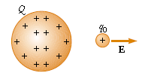
The Electric Field
The electric field vector E at a point in space is defined as the electric force Fe acting on a test charge q0 placed at that point divided by the test charge:
The vector E has the SI units of newtons per coulomb (N/C).
The force on a charged particle placed in an electric field:
If the charge q is positive, the force is in the same direction as the field.
If q is negative, the force and the field are in opposite directions.

Slide 16
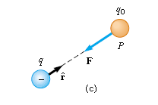
The Electric Field
According to Coulomb’s law, the force exerted by q on the test charge is
test charge
Where rˆ is a unit vector directed from q toward q₀ .
source charge
This force in Figure (a) is directed away from the source charge q.
we find that at P, the electric field created by q is
If the source charge q is positive the test charge removed—the source charge sets
up an electric field at point P, directed away from q.
If q is negative the force on the test charge is toward the
source charge, so the electric field at P is directed toward

Slide 17
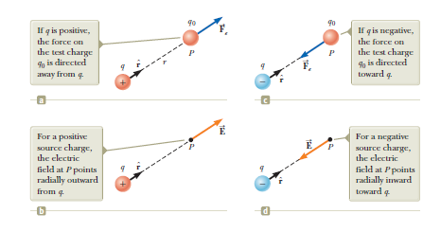
The Electric Field

Slide 18
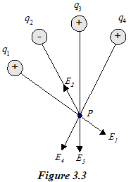
The Electric Field
At any point P, the total electric field due to a group of source charges
equals the vector sum of the electric fields of all the charges.
Thus, the electric field at point P due to a group of source charges can be
expressed as the vector sum
E_{p} = E₁ + E₂ + E₃ +E₄

Slide 19
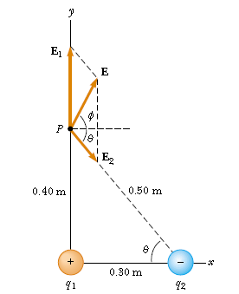
Example 5
Electric Field Due to Two Charges
A charge q₁ = 7.0 µC is located at the origin, and a second charge q₂ = -5.0 µC is located on the x axis, 0.30 m from the origin. Find the electric field at the point P, which has coordinates (0, 0.40) m.

Slide 20
Electric Field Lines
The relation between the electric field lines and the electric field vector is this:
(1) The tangent to a line of force at any point gives the direction of E at that point.
(2) The lines of force are drawn so that the number of lines per unit cross-sectional
area is proportional to the magnitude of E.
Notice that the rule of drawing the line of force:-
(1)The lines must begin on positive charges and terminates on negative charges.
(2)The number of lines drawn is proportional to the magnitude of the charge.
(3) No two electric field lines can cross each other.

Slide 21
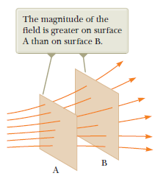
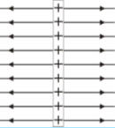
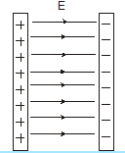
Electric Field Lines
Some examples of electric line of force
Electric field lines due to +ve line charge | Electric field lines due two surface charge

Slide 22
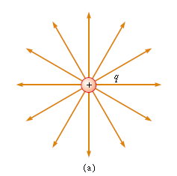
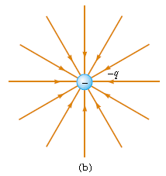
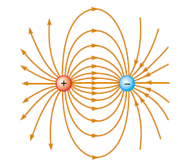
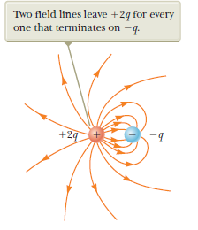
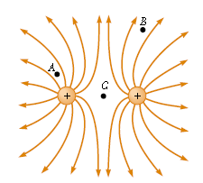
Electric Field Lines
The electric field lines for two point charges of equal magnitude and opposite sign (an electric dipole). The number of lines leaving the positive charge equals the number terminating at the negative charge.
  The electric field lines for a point charge. (a) For a positive point charge, the lines are directed radially outward. (b) For a negative point charge, the lines are directed radially inward.
The number of lines leaving +2q is twice the number terminating at -q. Hence, only half the lines that leave the positive charge reach the negative charge. The remaining half terminate on a negative charge we assume to be at infinity.
The electric field lines for two positive point charges.

